Slide 1
exceptions
Concurrency

Slide 2
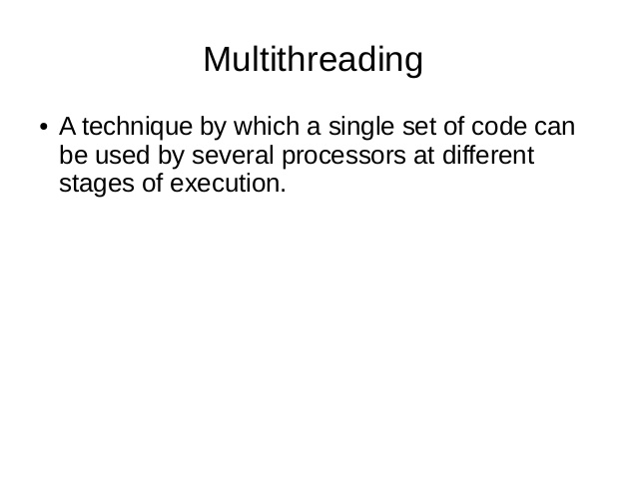
exceptions

Slide 3
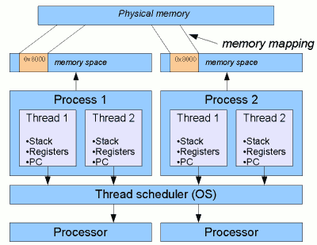
exceptions

Slide 4
exceptions
Processes
A self contained execution environment.
It has private set of basic run time resources particularly has its own memory space.
Processes communicate with each other through operating system supported Inter Process Communication (IPC) resources, such as pipes and sockets.
Most implementations of the Java virtual machine run as a single process.
A Java application can create additional processes using a ProcessBuilder object.

Slide 5
exceptions
Threads
Sometimes referred as “light weight processes”.
Creating a thread requires fewer resources than creating new process.
Threads exists within a process.
Every process has at least one thread.
Threads share the process's resources, including memory and open files

Slide 6
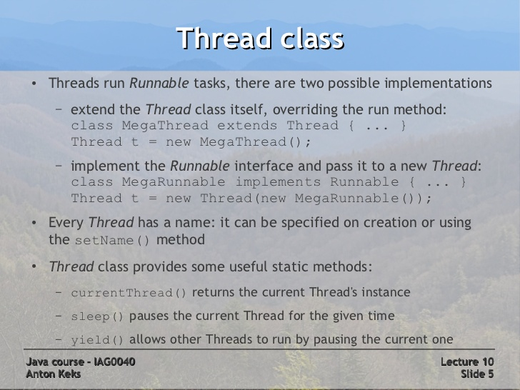
exceptions

Slide 7
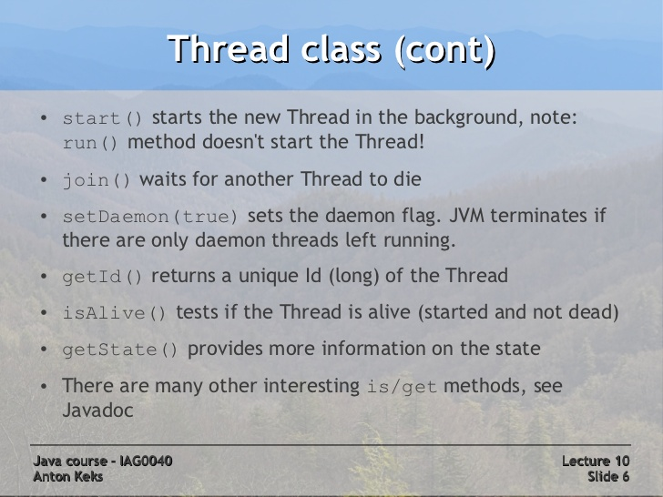
exceptions

Slide 8
exceptions

Slide 9
exceptions
Creating Threads – by implementing Runnable
public class HelloRunnable implements Runnable {
public void run() {
System.out.println("Hello from a thread!");
}
public static void main(String args[]) {
(new Thread(new HelloRunnable())).start();
}
}
Lab18.1: Creating threads using Runnable

Slide 10
exceptions
Creating Threads – by extending Thread class
public class HelloThread extends Thread {
public void run() {
System.out.println("Hello from a thread!");
}
public static void main(String args[]) {
(new HelloThread()).start();
}
}
Lab18.2: Creating threads using Thread class

Slide 11
exceptions
Threads – pausing execution
public static void main(String args[])
throws InterruptedException {
String importantInfo[] = { "Mares eat oats", "Does eat oats",
"Little lambs eat ivy","A kid will eat ivy too" };
for (int i = 0;
i < importantInfo.length;
i++) {
//Pause for 4 seconds
Thread.sleep(4000);
//Print a message
System.out.println(importantInfo[i]);
}
}
Lab18.3: Pausing thread execution by invoking sleep

Slide 12
exceptions
Threads – interrupting thread
public class TestInterruptingThread1 extends Thread{
public void run(){
try{
Thread.sleep(1000);
System.out.println("task");
}catch(InterruptedException e){
throw new RuntimeException("Thread interrupted..."+e);
}
}
public static void main(String args[]){
TestInterruptingThread1 t1=new TestInterruptingThread1();
t1.start();
try{
t1.interrupt();
}catch(Exception e){
System.out.println("Exception handled "+e);
}
}
If any thread is in sleeping or waiting state (i.e. sleep() or wait() is invoked), calling the interrupt() method on the thread, breaks out the sleeping or waiting state throwing InterruptedException.
If the thread is not in the sleeping or waiting state, calling the interrupt() method performs normal behaviour and doesn't interrupt the thread but sets the interrupt flag to true
Lab18.4: Interrupting threads.:

Slide 13
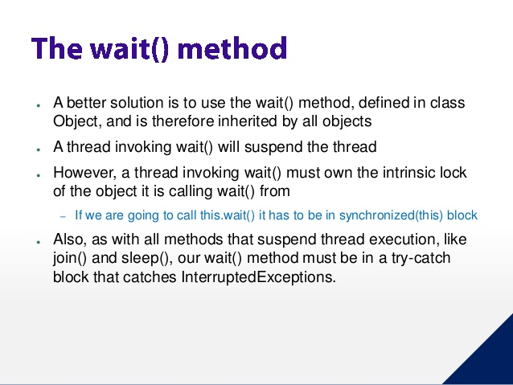
exceptions

Slide 14
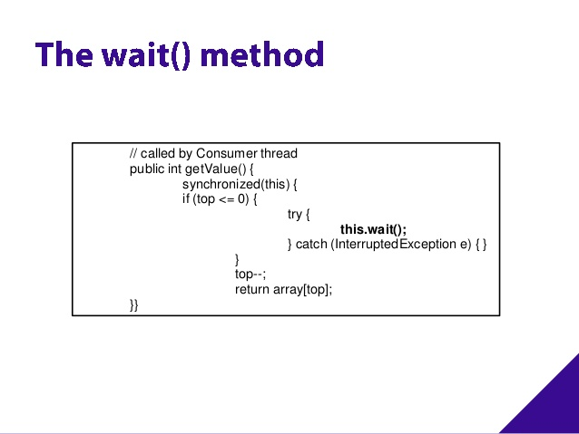
exceptions

Slide 15
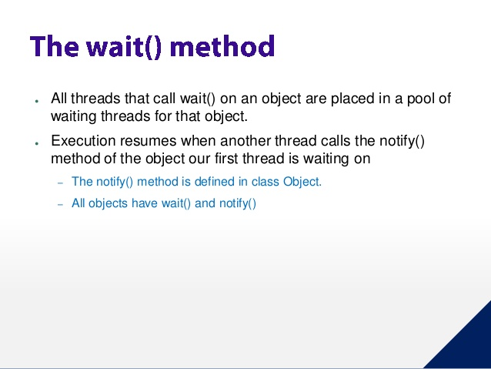
exceptions

Slide 16
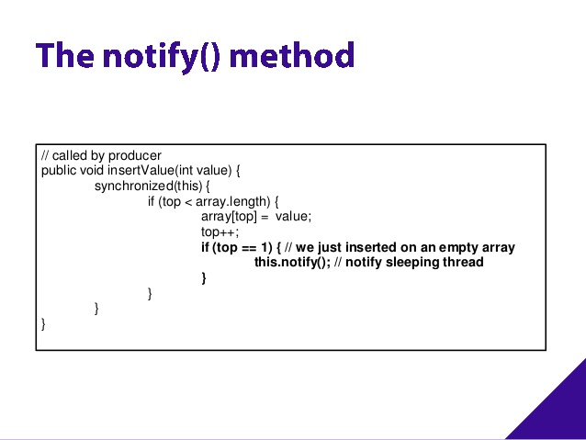
exceptions

Slide 17
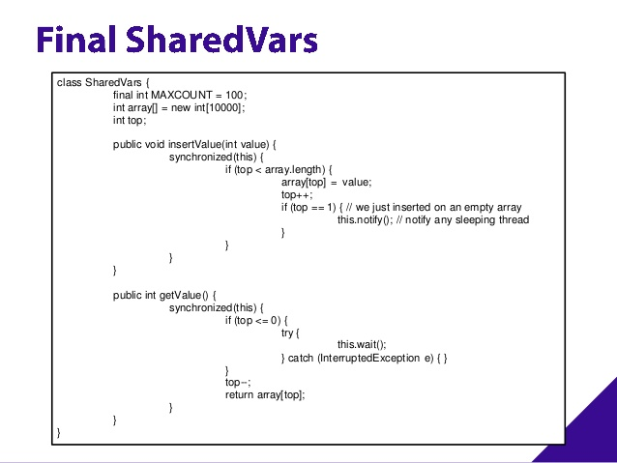
exceptions

Slide 18
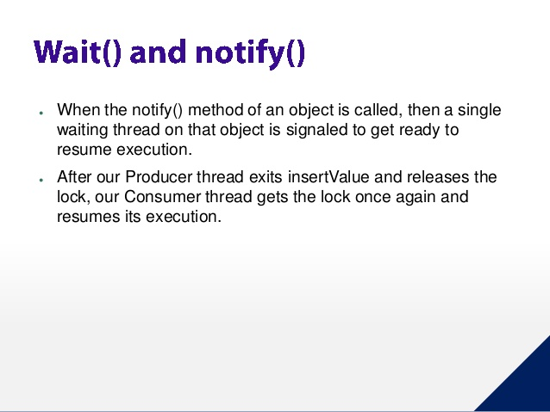
exceptions

Slide 19
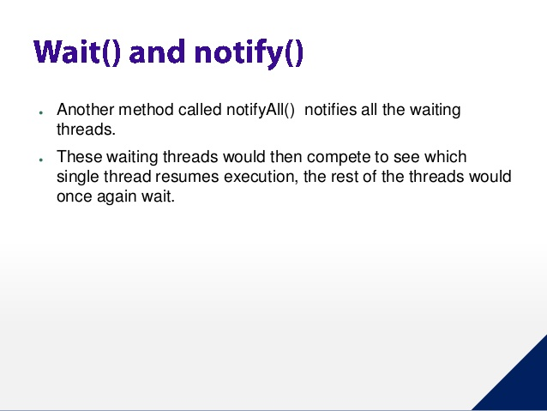
exceptions

Slide 20
exceptions
Reentrant Synchronization
Allowing a thread to acquire the same lock more than once enables reentrant synchronization.
This describes a situation where synchronized code, directly or indirectly, invokes a method that also contains synchronized code, and both sets of code use the same lock. Without reentrant synchronization, synchronized code would have to take many additional precautions to avoid having a thread cause itself to block

Slide 21
exceptions

Slide 22
exceptions

Slide 23
exceptions

Slide 24
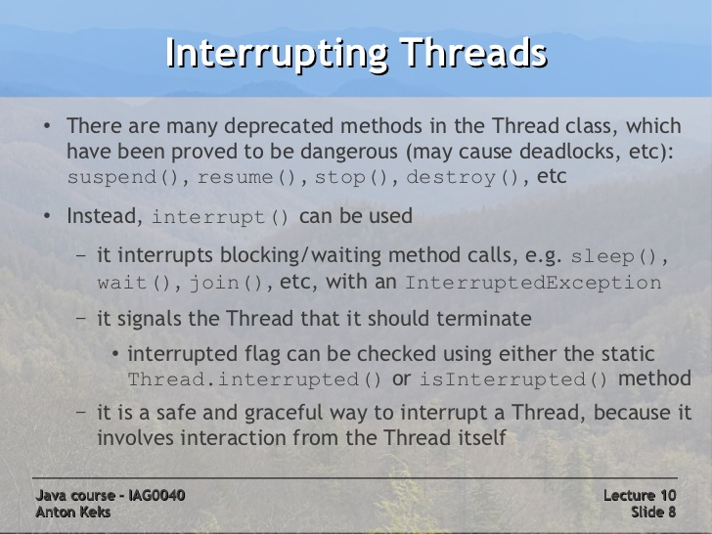
exceptions

Slide 25
exceptions
Threads – Joining threads
Allows one thread to wait for the completion of another
join responds to an interrupt by exiting with an InterruptedException
public static void main(String args[]){
TestJoinMethod1 t1=new TestJoinMethod1();
TestJoinMethod1 t2=new TestJoinMethod1();
TestJoinMethod1 t3=new TestJoinMethod1();
t1.start();
try{
t1.join();
}catch(Exception e){System.out.println(e);}
t2.start();
t3.start();
}
}
Lab18.5: Joining threads
Lab18.6: Interrupting threads – Example 2

Slide 26
exceptions
Thread Interference:
Lab18.6: Demonstration of thread interference
Interference happens when two operations, running in different threads, but acting on the same data, interleave.
Memory consistency errors occur when different threads have inconsistent views of what should be the same data

Slide 27
exceptions
Synchronization
Lab18.7: Demonstration of avoiding thread interference using synchronization:
synchronized methods
public synchronized void increment() {
c++;
}
Making these methods synchronized has two effects,
First, it is not possible for two invocations of synchronized methods on the same object to interleave. When one thread is executing a synchronized method for an object, all other threads that invoke synchronized methods for the same object block (suspend execution) until the first thread is done with the object.
Second, when a synchronized method exits, it automatically establishes a happens-before relationship withany subsequent invocation of a synchronized method for the same object. This guarantees that changes to the state of the object are visible to all threads.

Slide 28
xcptions
Synchronization …….
Making these methods synchronized has two effects,
First, it is not possible for two invocations of synchronized methods on the same object to interleave. When one thread is executing a synchronized method for an object, all other threads that invoke synchronized methods for the same object block (suspend execution) until the first thread is done with the object.
Second, when a synchronized method exits, it automatically establishes a happens-before relationship withany subsequent invocation of a synchronized method for the same object. This guarantees that changes to the state of the object are visible to all threads.
constructors cannot be synchronized
When a static synchronized method is invoked, thread acquires the intrinsic lock for the Class object associated with the class

Slide 29
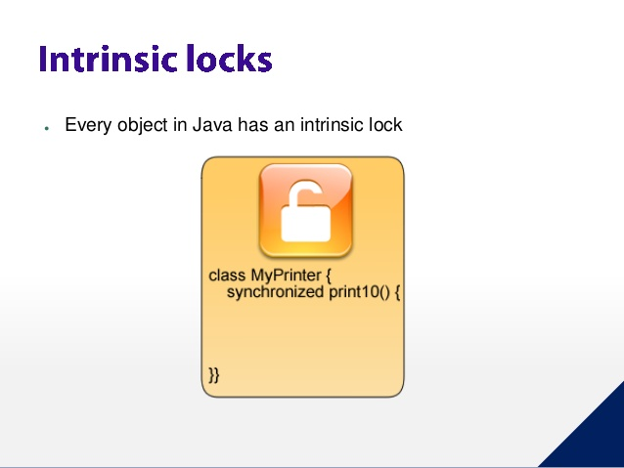
exceptions

Slide 30
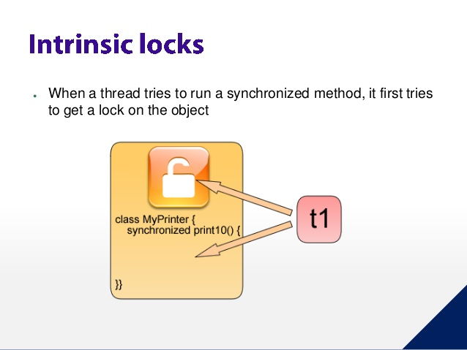
exceptions

Slide 31
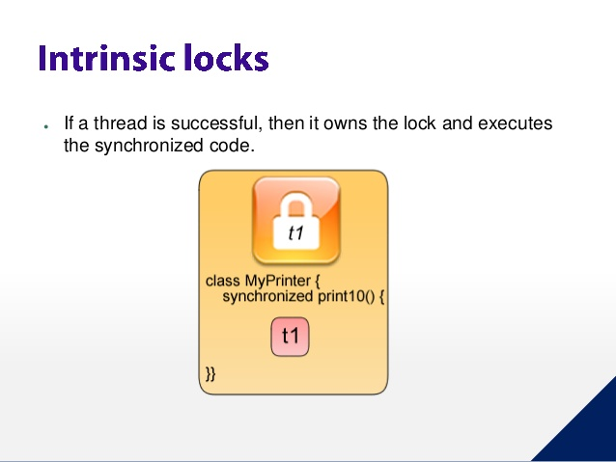
exceptions

Slide 32
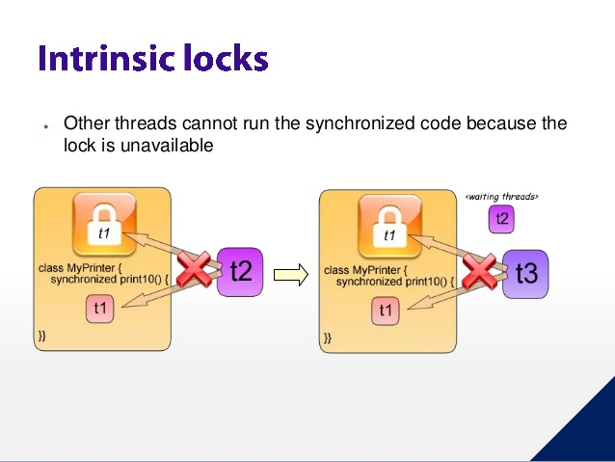
exceptions

Slide 33
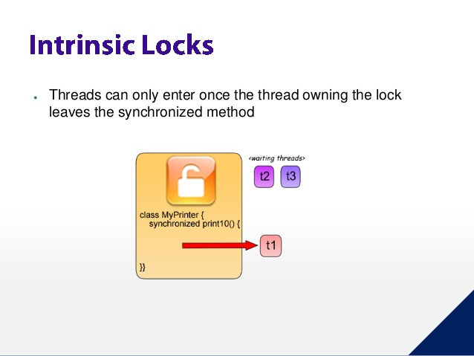
exceptions

Slide 34
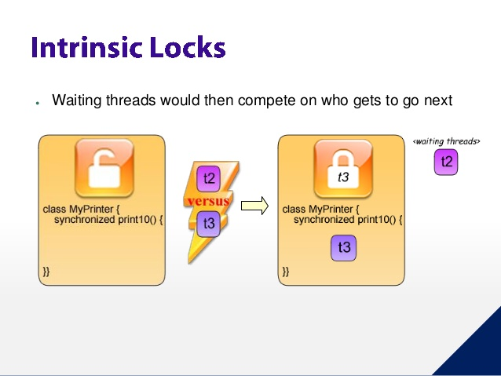
exceptions

Slide 35
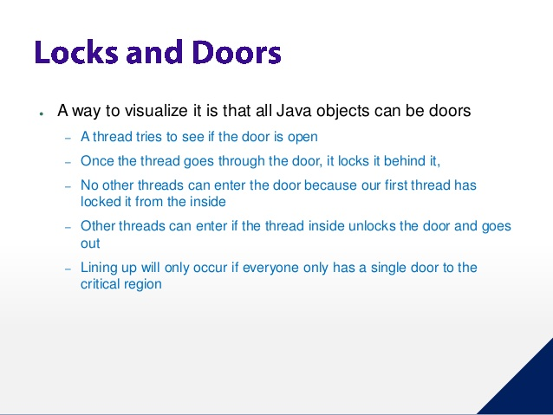
exceptions

Slide 36
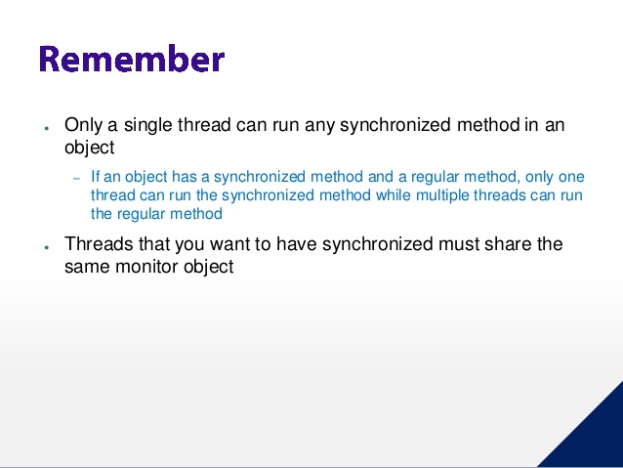
exceptions

Slide 37
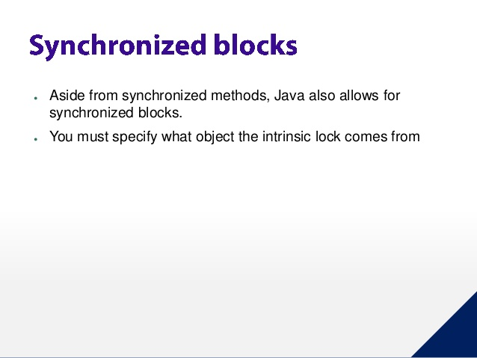
exceptions

Slide 38
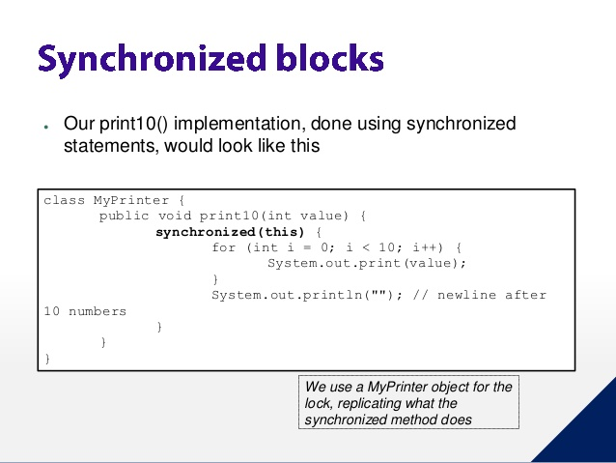
exceptions

Slide 39
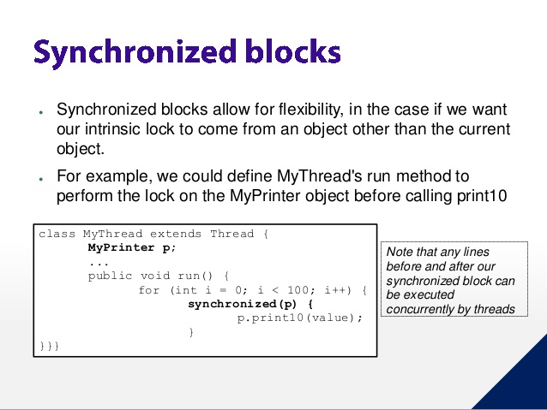
exceptions

Slide 40
xcptions
Synchronization …….
Synchronized method
public synchronized void method() { // blocks "this" from here....
...
...nc
...
} /
synchronized statements
public void addName(String name) {
synchronized(this) {
lastName = name;
nameCount++;
}
nameList.add(name);
}
nc
Synchronized statement
public void method() {
synchronized( this ) { // blocks "this" from here ....
....
....
....
} // to here...
}

Slide 41
xcptions
Synchronization …….
Unlike synchronized methods, synchronized statements must specify the object that provides the intrinsic lock.

Slide 42
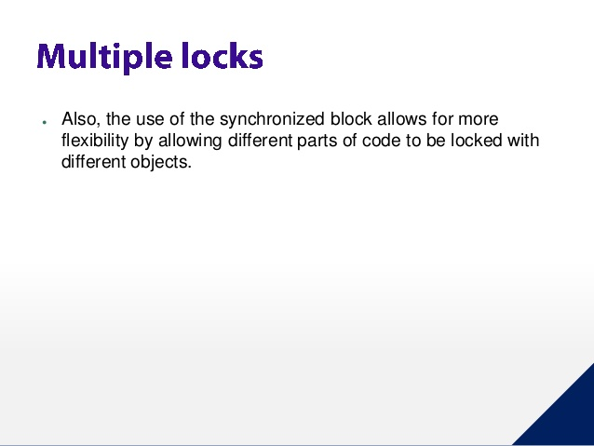
exceptions

Slide 43
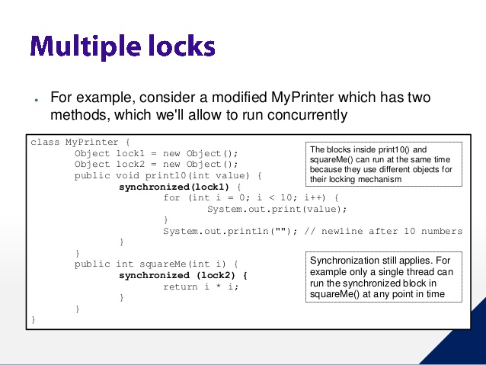
exceptions

Slide 44
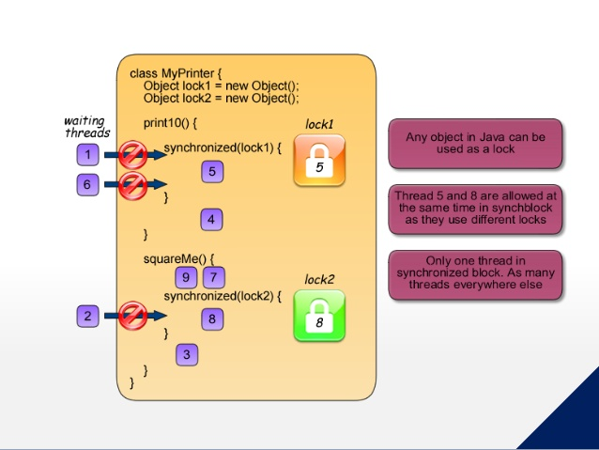
exceptions

Slide 45
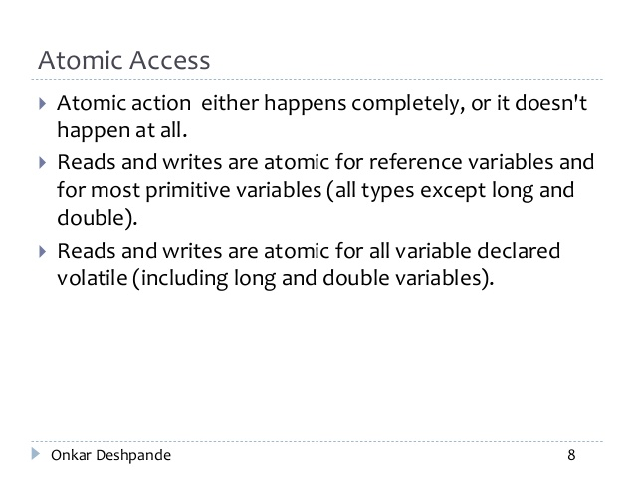
exceptions
Volatile only ensures that the access is atomically, while Atomics ensure that the operation is atomically.

Slide 46
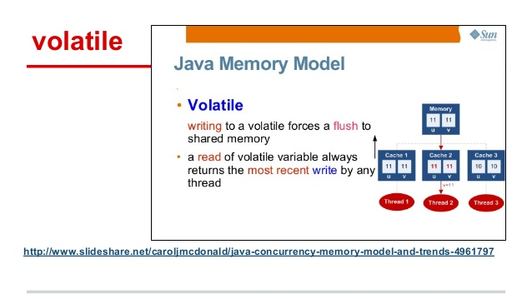
exceptions

Slide 47
exceptions

Slide 48
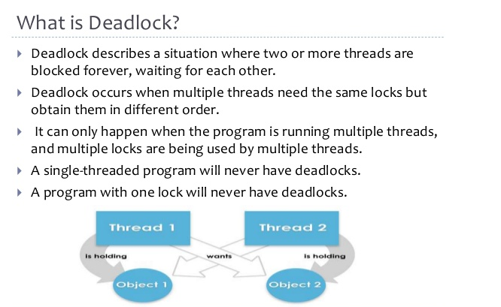
exceptions
Lab18.9: Demonstration of threads dead lock:

Slide 49
exceptions
Lab18.9: Demonstration of threads dead lock:
Alphonse and Gaston are friends, and great believers in courtesy. A strict rule of courtesy is that when you bow to a friend, you must remain bowed until your friend has a chance to return the bow. Unfortunately, this rule does not account for the possibility that two friends might bow to each other at the same time.

Slide 50
exceptions
Lab18.10: Demonstration of solving threads dead lock

Slide 51
exceptions

Slide 52
exceptions

Slide 53
exceptions
Guarded Blocks
CPU cycles are wasted since it executes while continuously waiting
public void guardedJoy() {
// Simple loop guard. Wastes
// processor time. Don't do this!
while(!joy) {}
System.out.println("Joy has been achieved!");
}
A better approach
public synchronized void guardedJoy() {
// This guard only loops once for each special event, which may not
// be the event we're waiting for.
while(!joy) {
try {
wait();
} catch (InterruptedException e) {}
}
System.out.println("Joy and efficiency have been achieved!");
}
public synchronized notifyJoy() {
joy = true;
notifyAll();
}

Slide 54
exceptions
Guarded Blocks ……
Lab18.11: Demonstration of Guarded blocks:
Let's use guarded blocks to create a Producer-Consumer application. This kind of application shares data between two threads: the producer, that creates the data, and the consumer, that does something with it. The two threads communicate using a shared object. Coordination is essential: the consumer thread must not attempt to retrieve the data before the producer thread has delivered it, and the producer thread must not attempt to deliver new data if the consumer hasn't retrieved the old data.

Slide 55
exceptions

Slide 56
exceptions

Slide 57
exceptions

Slide 58
exceptions

Slide 59
exceptions
Lock Objects …..
Advantages over Implicit lock
Lock objects can easily back out of an attempt to acquire a lock.
The tryLock method backs out if the lock is not available immediately or before a timeout expires (if specified).
The lockInterruptibly method backs out if another thread sends an interrupt before the lock is acquired

Slide 60
exceptions

Slide 61
exceptions
Lock Objects …..
Lab18.12: Demonstration of Using Locks:
Alphonse and Gaston are friends, and great believers in courtesy. A strict rule of courtesy is that when you bow to a friend, you must remain bowed until your friend has a chance to return the bow. Unfortunately, this rule does not account for the possibility that two friends might bow to each other at the same time.
Solve the above deadlock problem using Lock object.

Slide 62
exceptions

Slide 63
exceptions

Slide 64
exceptions

Slide 65
exceptions
The Executors
Executor interface
The low-level idiom creates a new thread and launches it immediately
(new Thread(r)).start();
with
e.execute(r);
The ExecutorService Interface
The ExecutorService interface supplements execute with a similar, but more versatile submit method.
Like execute, submit accepts Runnable objects, but also accepts Callable objects, which allow the task to return a value.
The submit method returns a Future object, which is used to retrieve the Callable return value and to manage the status of both Callable and Runnable tasks.
ExecutorService provides a number of methods for managing the shutdown of the executor.

Slide 66
exceptions
The Executors ….
The ScheduledExecutorService Interface
The ScheduledExecutorService interface supplements the methods of its parent ExecutorService with schedule, which executes a Runnable or Callable task after a specified delay.

Slide 67
exceptions
Thread Pool
Collection of Runnable objects (work queue) and collections of worker threads.
Worker threads minimizes the overhead due to thread creation.
Fixed thread pool always has a specified number of threads running; if a thread is somehow terminated while it is still in use, it is automatically replaced with a new thread. Tasks are submitted to the pool via an internal queue, which holds extra tasks whenever there are more active tasks than threads
An important advantage of the fixed thread pool is that applications using it degrade gracefully (Ex: a webserver serving many requests).
java.util.concurrent.Executors class also provides serveral factory methods for creating thread pools.

Slide 68
exceptions

Slide 69
exceptions
Lab18.13: Demonstration of Using Fork/Join

Slide 70
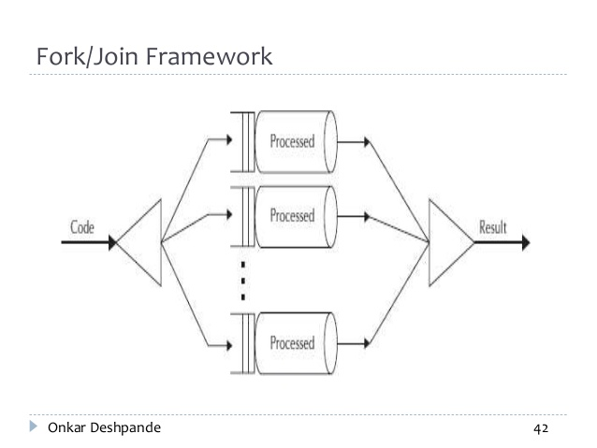
exceptions

Slide 71
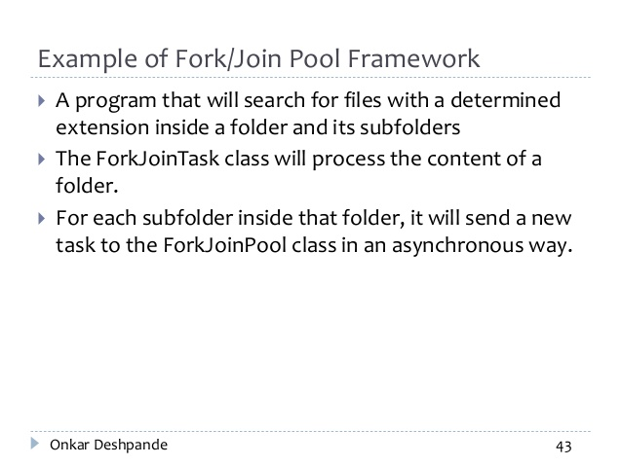
exceptions

Slide 72
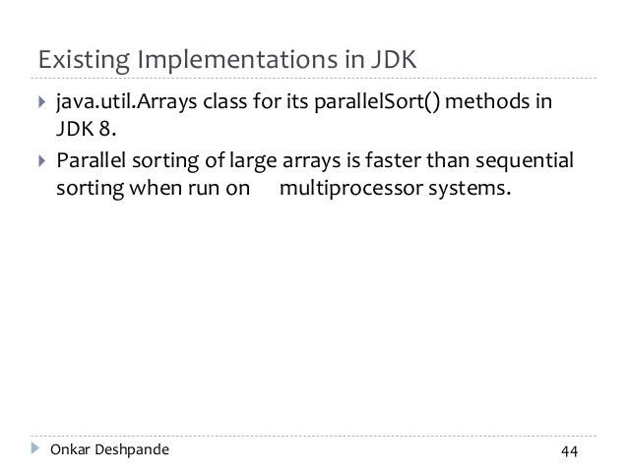
exceptions

Slide 73
exceptions

Slide 74
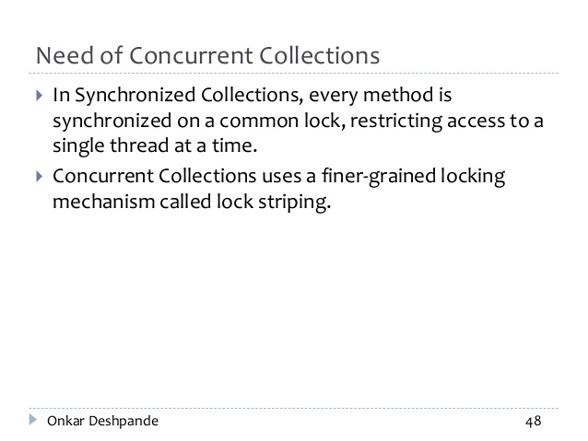
exceptions

Slide 75
exceptions
Concurrent Collection Classes
BlockingQue
SynchronousQueue
ConcurrentMap
ConcurrentHashMap
ConcurrentNavigableMap
ConcurrentSkipListMap

Slide 76
exceptions
Concurrent Collection Classes …..
All Known Implementing Classes:
ArrayBlockingQueue, DelayQueue, LinkedBlockingDeque, LinkedBlockingQueue, LinkedTransferQueue, PriorityBlockingQueue, SynchronousQueue

Slide 77
exceptions

Slide 78
exceptions

Slide 79
exceptions

Slide 80
exceptions

Slide 81
exceptions

Slide 82
exceptions

Slide 83
exceptions

Slide 84
exceptions

Slide 85
exceptions

Slide 86
exceptions
Atomic Variables
Revisit the counter example:
Lab18.7: Demonstration of avoiding thread interference using synchronization:
Lab18.14: Demonstration of Using Atomic variables to avoid synchronization:
The java.util.concurrent.atomic package defines classes that support atomic operations on single variables.

Slide 87
exceptions
ThreadLocalRandom
ThreadLocalRandom is used in applications that expect to use random numbers from multiple threads or ForkJoinTasks.
For concurrent access, using ThreadLocalRandom instead of Math.random() results in less contention and, ultimately, better performance
Ex:
int r = ThreadLocalRandom.current() .nextInt(4, 77);

Slide 88
exceptions

Slide 89
exceptions

Slide 90
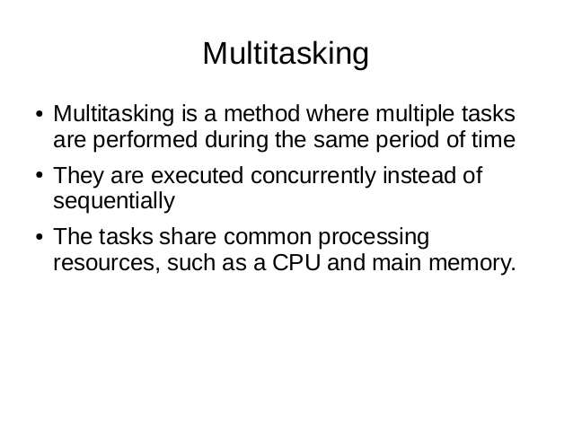
exceptions

Slide 91
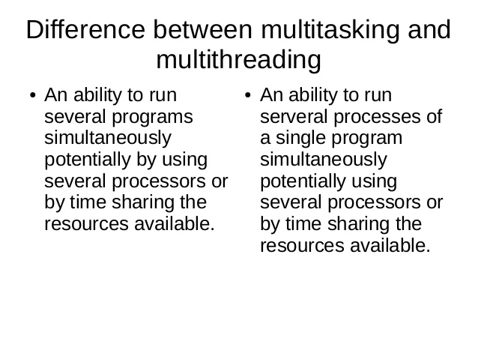
exceptions

Slide 92
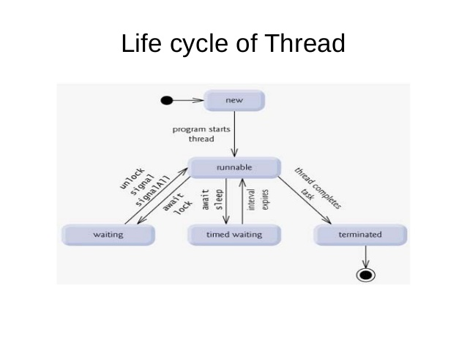
exceptions

Slide 93
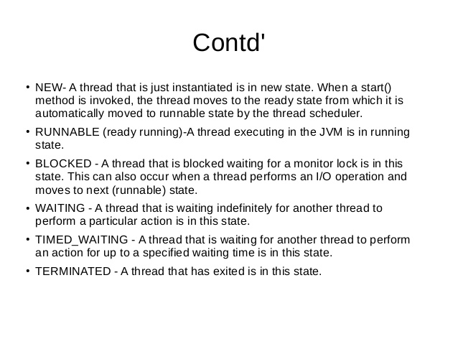
exceptions

Slide 94
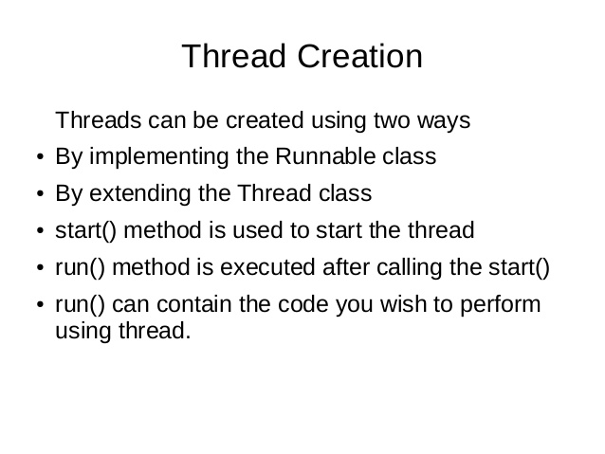
exceptions

Slide 95
exceptions

Slide 96
exceptions

Slide 97
exceptions

Slide 98
exceptions

Slide 99
exceptions

Slide 100
Java - miscellaneous
Type Comparison Operator instanceof
The instanceof operator compares an object to a specified type.
You can use it to test if an object is an instance of a class, an instance of a subclass, or an instance of a class that implements a particular interface
Classes implementing interfaces
class MyClass extends MySuperClass implements YourInterface {
// field, constructor, and
// method declarations
}

Slide 101
Java - miscellaneous
Varargs – Specifying Arbitrary number of arguments
public Polygon polygonFrom(Point... corners) {
int numberOfSides = corners.length;
double squareOfSide1, lengthOfSide1;
squareOfSide1 = (corners[1].x - corners[0].x)
* (corners[1].x - corners[0].x)
+ (corners[1].y - corners[0].y)
* (corners[1].y - corners[0].y);
lengthOfSide1 = Math.sqrt(squareOfSide1);
// more method body code follows that creates and returns a
// polygon connecting the Points
}
You will most commonly see varargs with the printing methods; for example, this printf method:
public PrintStream printf(String format, Object... args)
allows you to print an arbitrary number of objects. It can be called like this:
System.out.printf("%s: %d, %s%n", name, idnum, address);

Slide 102
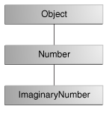
Java - miscellaneous
Returning a Class or Interface
When a method uses a class name as its return type the class of the type of the returned object must be either a subclass of, or the exact class of, the return type.
public Number returnANumber() {
...
}
The returnANumber method can return an ImaginaryNumber but not an Object. ImaginaryNumber is a Number because it's a subclass of Number. However, an Object is not necessarily a Number — it could be a String or another type

Slide 103
Advanced java
Garbage collection
JDBC
Lambda expressions
Annotations
Aggregate operations on collection using Lambarda expression.
Java streaming
Blocking queue
Aggregate operations
Autoboxing and unboxing

Slide 104
https://docs.oracle.com/javase/tutorial/reallybigindex.html
http://www.slideshare.net/EdurekaIN/java-class-3
http://www.slideshare.net/abdurrehmanabdurrehman391/variables-and-data-types-by-sir-khalid
http://www.slideshare.net/abdurrehmanabdurrehman391/java-advancedoop
http://www.slideshare.net/MindfireSolutions/java-garbage-collection-how-it-works?next_slideshow=1
http://www.slideshare.net/arnold7490/unit-4-java
http://www.slideshare.net/arnold7490/unit-3-java?next_slideshow=1
http://www.slideshare.net/tushardesarda/java-tutorial-3
http://www.slideshare.net/muralidhar9e/java-exception-handling-ppt
http://www.slideshare.net/emprovise/2-javabasics
http://www.slideshare.net/AllanHuang/java-new-evolution
http://www.slideshare.net/antonkeks/4-collections
http://www.slideshare.net/andreaiacono/java8-39841939 - Java8 features
http://www.slideshare.net/AbhishekKhune/07-java-collection
http://www.slideshare.net/shahjahan786/generics-27960064 - Generics
http://www.slideshare.net/caroljmcdonald/java-generics-2485138?next_slideshow=1

Slide 105
http://www.slideshare.net/KavitaGanesan/is-66154415-kavitaganesanv2 - Strings
http://www.slideshare.net/antonkeks/10-threads - Threads
http://www.slideshare.net/BenjDelMundo/java-thread-synchronization - Synchronization
http://www.slideshare.net/javaonkar/thread-concurrancy - Synchronization

